Slide 1

Spam Mail Detection using TF-IDF
SRM INSTITUTE OF SCIENCE AND TECHNOLOGY
FACULTY OF ENGINEERING AND TECHNOLOGY
DEPARTMENT OF NETWORKING AND COMMUNICATIONS
Akshat Neolia (RA2211031010080)

Slide 2
Abstract
Spam emails pose a significant challenge in digital communication, leading to security threats and unnecessary clutter. This project implements a machine learning-based spam detection system using Python, leveraging natural language processing techniques. The model is trained using a dataset containing labeled emails, where TF-IDF (Term Frequency-Inverse Document Frequency) vectorization is applied to convert textual data into numerical features. Naïve Bayes model is employed for classification, distinguishing between spam and non-spam (ham) emails. The system is evaluated based on accuracy on both training and testing datasets, demonstrating its effectiveness in spam detection. The implementation is structured into data preprocessing, feature extraction, model training, and prediction. This project provides an efficient and scalable approach to automatically identifying spam emails, enhancing email security and user experience.

Slide 3
Introduction
Overview: Spam mail detection is a crucial application of machine learning that helps in identifying and filtering out unwanted or harmful emails. Spam messages often contain phishing attempts, advertisements, or malicious content, making automated detection essential for cybersecurity. An effective spam detection system improves email security, enhances productivity, and ensures a clutter-free inbox.
Role of TF-IDF: Term Frequency-Inverse Document Frequency (TF-IDF) is a widely used technique for feature extraction in text classification. It converts raw text data into numerical form by assessing the importance of words in a collection of emails. By reducing the influence of common words and highlighting significant terms, TF-IDF enhances the accuracy of spam classification, making it easier for the model to differentiate spam from legitimate emails.

Slide 4
Introduction
Objective: The primary objective of this project is to develop an efficient and accurate spam detection system using machine learning techniques. By leveraging TF-IDF for feature extraction and applying a logistic regression model for classification, the system can effectively identify spam emails. The goal is to achieve high accuracy in distinguishing spam from ham emails, providing a reliable and automated solution for email filtering.

Slide 5
Motivation
In the digital age, email communication has become an integral part of personal and professional life. However, with the increasing volume of emails, the risk of receiving spam or malicious content has also risen significantly. Spam emails not only clutter inboxes but also pose serious security threats, including phishing attacks, malware distribution, and fraudulent schemes.
Traditional rule-based spam detection systems are limited in their ability to adapt to the evolving tactics of spammers. Therefore, machine learning-based approaches more intelligent and scalable solution.
Our motivation is to use TF-IDF (Term Frequency-Inverse Document Frequency) to find important patterns in email text and build an effective spam detection system. By testing different machine learning algorithms, we aim to accurately identify and separate spam emails from real ones. This project will help improve online security and make email management easier for users.

Slide 6
Literature Review
Title | Author | (Published Year)
SMS Spam Message Detection using Term Frequency-Inverse Document Frequency and Random Forest Algorithm.Paper Link TF-IDF Feature-Based Spam Filtering of Mobile SMS Using a Machine Learning Approach. Paper Link A Novel Method of Spam Mail Detection using Text Based Clustering Approach. Paper Link Detecting spam e-mails using stop word TF-IDF and stemming algorithm with Naïve Bayes classifier on the multicore GPU. Paper Link | Nilam Nur Amir Sjarif, Nurulhuda Firdaus MohdAzmi, Suriayati Chuprat, HaslinaMd Sarkan, Yazriwati Yahya, Suriani Mohd Sam Syed Md. Minhaz Hossain, Khaleque Md. Aashiq Kamal, Anik Sen, Iqbal H. Sarker M. Basavaraju, Dr. R. Prabhakar Jaiswal, Manjit; Das, Sukriti; Khushboo | 2023 2023 2022 2021

Slide 7

Scope & Application
Email Security Enhancement
Business Communication Protection
Cybersecurity Improvements
Education
Scalable for Enterprises
Automated Spam Filtering

Slide 8

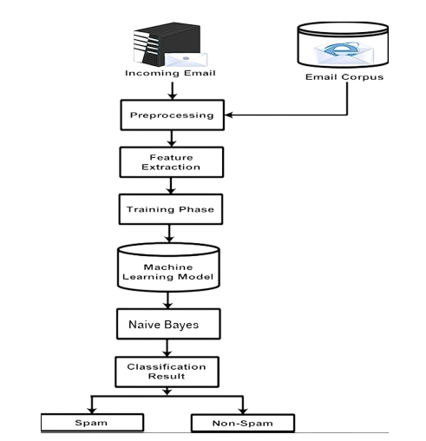
Architecture Diagram

Slide 9
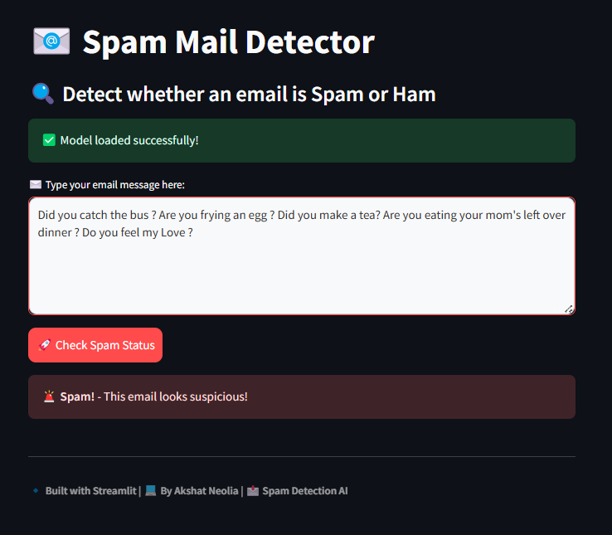
Final Result Analysis / Output

Slide 10
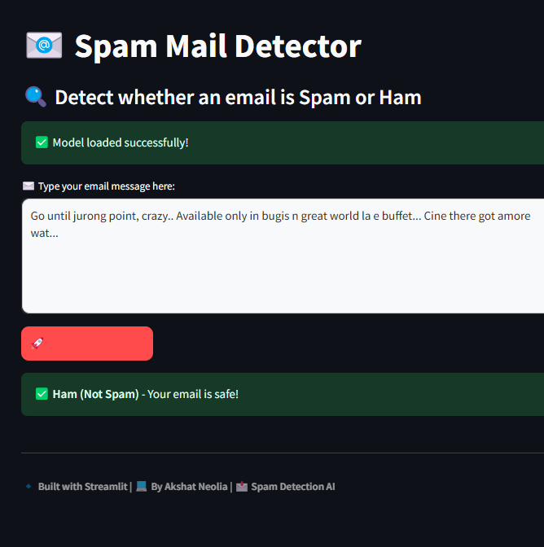
Final Result Analysis / Output

Slide 11
References
Jaiswal, M. and Das, S., 2021. Detecting spam e-mails using stop word TF-IDF and stemming algorithm with Naïve Bayes classifier on the multicore GPU. International Journal of Electrical & Computer Engineering (2088-8708), 11(4).
Sjarif, N.N.A., Azmi, N.F.M., Chuprat, S., Sarkan, H.M., Yahya, Y. and Sam, S.M., 2019. SMS spam message detection using term frequency-inverse document frequency and random forest algorithm. Procedia Computer Science, 161, pp.509-515.
Sjarif, N.N.A., Azmi, N.F.M., Chuprat, S., Sarkan, H.M., Yahya, Y. and Sam, S.M., 2019. SMS spam message detection using term frequency-inverse document frequency and random forest algorithm. Procedia Computer Science, 161, pp.509-515.
Hossain, S.M.M., Kamal, K.M.A., Sen, A. and Sarker, I.H., 2023. TF-IDF feature-based spam filtering of mobile SMS using a machine learning approach. In Applied Intelligence for Industry 4.0 (pp. 162-175). Chapman and Hall/CRC.
Saputra, N.J., 2024. Analysis of sms spam detection using tf-idf: A study on sms spam collection dataset. Jurnal Sosial Teknologi, 4(4), pp.213-217.
Chavez, A., 2020. TF-IDF classification based Multinomial Naïve Bayes model for spam filtering (Doctoral dissertation, Dublin, National College of Ireland).
Yusupov, K., Islam, M.R., Muminov, I., Sahlabadi, M. and Yim, K., 2024, November. Comparative Analysis of Machine Learning and Deep Learning Models for Email Spam Classification Using TF-IDF and Word Embedding Techniques. In International Conference on Broadband and Wireless Computing, Communication and Applications (pp. 114-122). Cham: Springer Nature Switzerland.
Aizawa, A., 2003. An information-theoretic perspective of tf–idf measures. Information Processing & Management, 39(1), pp.45-65.

Slide 12
THANKS

